Slide 1

IMDb MOVIE ANALYSIS

Slide 2

PROJECT DESCRIPTION
IMDb stands for the Internet Movie Database. It is an online database that was founded in 1990 and is now one of the most comprehensive sources of information related to movies, TV shows, actors, directors, and other entertainment content.
I was given a dataset with information related to movies from 1916 to 2016. My task was to clean the data and analyze the data related to genre, budget, movie duration, director, and language.

Slide 3







APPROACH
STEP 1: I cleaned the data that was provided to me.
STEP 2: Analyzed the cleaned data.
STEP 3: Gained insights from the analysis.
STEP 4: Created charts and graphs for those insights.
STEP 5: Created a presentation to outsource my information.
STEP 6: Presented my presentation.

Slide 4



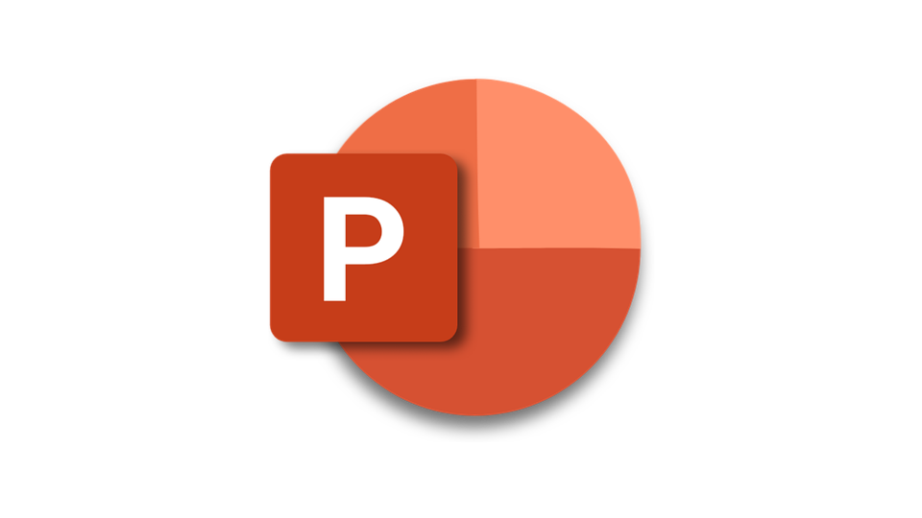
TECH-STACK USED
Excel(Microsoft 365 version)
Used to analyze the dataset provided to me.
PowerPoint(Microsoft 365 version)
Used to create and present the presentation.

Slide 5

INSIGHTS
Movie genre analysis:
Determine the most common genres of movies in the dataset.
Movie duration analysis:
Analyze the distribution of movie durations and its impact on the IMDb scores.
Language analysis:
Determine the most common languages used in movies and analyze the impact on IMDb scores.
Director analysis:
Identify the top directors based on their average IMDb scores.
Budget analysis:
Analyze the correlation between movie budgets and gross earnings and identify the movies with the highest profit margin.

Slide 6
A. MOVIE GENRE ANALYSIS

Slide 7


INSIGHTS: Movie genre analysis
STEPS PERFORMED
Firstly, I extracted movie_title, imdb_scores, and genres columns from the cleaned data.
Then I separated genres into different columns using text to columns command and identified all the unique genres. There were a total of 24 genres.
Then I created a table with having movie name and all 24 genres as my columns. For each movie, if the genre is present among 24 then it will be 1 else it will be blank.
After that using the COUNTIFS function I created a table having information about how many movies were created for a genre and IMDb scores.
This table helped me to gain the descriptive statistics i.e., mean, median, mode, max, min, variance, and standard deviation of the IMDb scores.

Slide 8

INSIGHTS: Movie genre analysis
INSIGHTS
There are a total of 24 genres.
Drama, Thriller, action, comedy, and romance are the top 5 genres that are performing well.
Genre drama has the maximum count of movies(128 movies) for a 7.2 IMDb score.
Drama, Comedy, and Thriller have an average count of 17-33 movies based on their IMDb scores.
Drama has comparatively greater variance and standard deviation compared to any other genre.

Slide 9



INSIGHTS: Movie genre analysis

Slide 10


INSIGHTS: Movie genre analysis

Slide 11
B. MOVIE DURATION ANALYSIS

Slide 12

INSIGHTS: Movie duration analysis
STEPS PERFORMED
At first, I extracted movie_title, IMDb_score and duration from the cleaned data.
Then I created class intervals for the duration column which I used to show the relationship with IMDb scores.
I created descriptive statistics for the duration column using the Data analysis command in the Analysis group which is in the data tab.
Then I created a separate table using class interval and IMDb scores which denotes how many movies were created within that duration and what is their IMDb score.

Slide 13


INSIGHTS: Movie duration analysis
INSIGHTS
Movies that run for 91-120 minutes have the highest number of films and tend to receive an IMDb score between 5.5 and 7.5.
Most of the movies are created with a duration of 61-120 minutes.
Shortest duration of a movie is 7 mins, and the longest duration is 330 mins.

Slide 14
INSIGHTS: Movie duration analysis

Slide 15
C. LANGUAGE ANALYSIS

Slide 16

INSIGHTS: Language analysis
STEPS PERFORMED
At first, I extracted movie_title, Language, and IMDb score columns from the cleaned data.
Using the data from the table, I created a pivot table to analyze the number of movies produced in each language and their corresponding IMDb scores.
I created one more table that denotes the number of movies produced in each language.
Then using the pivot table, I created a table that gives the mean, mode, median, max, min, variance, and standard deviation for each language.

Slide 17


INSIGHTS: Language analysis
INSIGHTS
94% are English movies.
Mean, median, and standard deviation of English movies are much greater than other movies.
207 English movies have an average IMDb score of 6.7.

Slide 18
INSIGHTS: Language analysis
Other languages 3%

Slide 19
INSIGHTS: Language analysis

Slide 20
INSIGHTS: Language analysis

Slide 21
D. DIRECTOR ANALYSIS

Slide 22

INSIGHTS: Director analysis
STEPS PERFORMED
At first, I extracted movie_title, director_name, and imdb_score columns from the cleaned data.
Using the data from the table, I created a pivot table that tells us how many movies were directed by each director and what is their average IMDb score.
From that table I was able to know the percentile of each director based on their IMDb score.
Using the data, I extracted the directors whose percentile is equal to or greater than 99%.

Slide 23


INSIGHTS: Director analysis
INSIGHTS
John Blanchard who has directed Towering Inferno which has an IMDb rating of 9.5 has a percentile of 100%.
Christoper Nolan’s has directed a total of 8 movies and its average IMDb score is 8.43 and has a percentile of 99.40%.
There are a total of 23 directors whose percentile is equal to or greater than the 99% percentile.

Slide 24
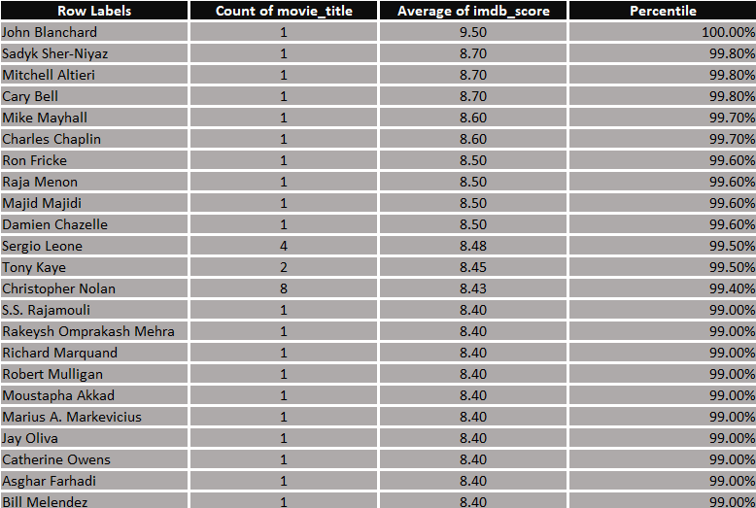

INSIGHTS: Director analysis

Slide 25

INSIGHTS: Director analysis

Slide 26
E. BUDGET ANALYSIS

Slide 27

INSIGHTS: Budget analysis
STEPS PERFORMED
At first, I extracted movie_title, gross, and budget columns from the cleaned data.
Then I created a column for the profit margin on each movie.
I also created a profit margin % column which tells the percentage increase of gross with respect to its budget.
Then by using the CORREL function I found the correlation coefficient between gross and budget.

Slide 28




INSIGHTS: Budget analysis
INSIGHTS
The correlation coefficient of gross and budget is 0.100969202. It means that they have a weak positive correlation which implies that if the budget increases it does not mean that the gross will also increase.
Avatar movie has the highest profit margin of $523 Million(approx.).
Paranormal Activity movie has the highest profit margin percentage of 719349% because it has a budget of $15000 but the gross reached $107 Million(approx.).

Slide 29

INSIGHTS: Budget analysis

Slide 30

Excel Link: click here

